Slide 1

Evaluating resource efficiency in US dairy farms
Aparna
Doctoral student
Texas A&M university

Slide 2
Background
Urgent Resource Challenges in Texas Dairy Farming
Broader Significance: Climate-Smart Dairy Production
Precision Dairy Technologies: Opportunities and Adoption Barriers
Energy Use Hotspots on Dairy Farms
Water Use Patterns and Optimization Potential
Integrating the WEF Nexus for Holistic Sustainability
Notes:
1. Urgent Resource Challenges in Texas Dairy FarmingTexas is among the top milk-producing states but faces increasing threats to agricultural sustainability due to severe water and energy constraints—especially in the arid Panhandle region. Groundwater from the Ogallala Aquifer is being depleted, and the state's high electricity demand results in grid instability. These constraints jeopardize long-term agricultural productivity and highlight the need for efficient on-farm resource optimization.2. Broader Significance: Climate-Smart Dairy ProductionAs global demand for food rises, sustainable and climate-resilient agricultural systems are essential. The rapid digital transformation of the dairy sector through precision technologies offers potential sustainability benefits, but also increases energy and water usage. There is a need to critically evaluate the net impact of these technologies within the framework of the Water-Energy-Food (WEF) Nexus and the UN Sustainable Development Goals.3. Precision Dairy Technologies: Opportunities and Adoption BarriersModern technologies—such as automatic milking systems (AMS) and precision livestock farming tools—improve efficiency, labor productivity, and animal welfare. However, adoption is lagging due to concerns over cost, support infrastructure, and demonstrable efficacy. Texas dairy farmers have identified the need for data-backed guidance to support informed adoption decisions.4. Energy Use Hotspots on Dairy FarmsElectricity is a major operational cost, with milking, milk cooling, and water heating being the largest consumers. Reports vary in identifying primary energy-use areas, highlighting the importance of long-term energy mapping to pinpoint high-consumption hotspots. This evaluation will inform targeted energy conservation strategies and alternative energy investments (e.g., agrivoltaics).5. Water Use Patterns and Optimization PotentialDirect water use in dairy farms—for drinking, cleaning, and equipment sanitation—is substantial and varies widely depending on farm setup and milking systems. Robotic systems typically use more water due to frequent wash cycles. Identifying and analyzing specific usage hotspots will enable implementation of water-saving practices without compromising production or hygiene.6. Integrating the WEF Nexus for Holistic SustainabilityThe WEF Nexus approach recognizes the interdependency of water, energy, and food systems. Applying this lens to dairy operations supports integrated resource management, improved resilience, and sustainability. The proposed project will utilize decision-support tools (e.g., agent-based modeling and optimization) to develop actionable strategies that guide both farm-level and policy-level interventions for resource efficiency and long-term sustainability.

Slide 3
Problem
Limited water and energy resources
Observation
Dairy farms use technology -opportunities for resource optimization
Fact:
Water and energy: critical resources. optimization of their use is warranted
Need:
Decision support tool for farm optimization- resource use & milk production
Outcome:
WEF-based program to optimize on-farm resource use
Impact:
Overall sustainability of dairy farms
RESEARCH GAP

Slide 4

OBJECTIVES
Evaluate direct electricity consumption in low-tech, and high-tech dairy farms
Analyze direct water use in low-tech, and high-tech dairy farms
Develop a Water-Energy-Food-Nexus model specific to the Texan dairy management system with varying levels of technology integration for decision-making for farm resource optimization using visualization tools.

Slide 5
Materials and methods
Farm selection
4 dairy farms (Dubblin and Lubbock)
Technology categories: Low tech and High tech
Data collection: 2 years
HOBO data loggers: THI
THIavg = (1.8 ×Ta+32)-(0.55−0.0055×RH)×(1.8×Ta-26)

Slide 6
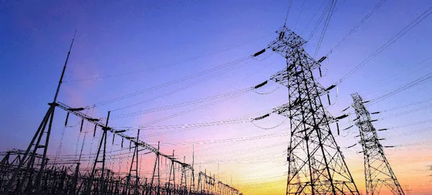
b)Direct electricity use monitoring
Identify relevant direct electricity use points to monitor
Install an electricity monitoring system
Milk harvesting systems, milk cooling systems (refrigeration), cleaning and sanitization processes, automation and control systems, and cow cooling systems. milk harvesting (vacuum pumps), water heating, water pumping, lighting
Data loggers (eGauge pro®), sensors, stored: data logger (EG4015)
Energy consumption (kWh) - calculated based on how much power is directly used for producing milk
Dynamics of electricity consumption: Seasonal Trend Decomposition using LOESS (STL)
Machine Learning algorithms such as Autoregressive Integrated Moving Average (ARIMA) or Long Short-Term Memory (LSTM)
Understand the hotspots of electricity use : clustering algorithms such as K-Means or DBSCAN

Slide 7
c) Monitoring water use
Comprehensive On-Farm Water Use Monitoring and Partitioning
Use of Advanced Metering and Sensor Technology : flow meters , 7 locations
Individual Cow-Level Water Intake Monitoring: SmaXtec
Monthly Water Audits for Leak Detection and Efficiency Tracking
Output Metrics and Resource Optimization Insights
Notes:
1. Comprehensive On-Farm Water Use Monitoring and Partitioning
The study will determine total annual pumped groundwater (blue water) use and partition it by type (e.g., drinking water, milk precooling, parlor cleaning) across up to six commercial dairies. Each farm's unique layout and operations will guide specific monitoring plans to ensure minimal disruption and capture farm-specific water usage patterns.
2. Use of Advanced Metering and Sensor Technology
A combination of portable transit-time flow meters and data loggers will be installed at key water use points—targeting at least seven locations per farm. Data will be collected daily and aggregated seasonally and annually to account for interannual and seasonal variability in water usage.
3. Individual Cow-Level Water Intake Monitoring
The study will utilize existing smaXtec rumen sensors on at least 3,000 cows at one farm to capture individual cow water intake patterns. This detailed data will support cow-level decisions for resource efficiency, including breeding and culling based on drinking behavior and productivity.
4. Monthly Water Audits for Leak Detection and Efficiency Tracking
Monthly in-person audits will retrieve sensor data, identify abnormal flows, detect leaks, and provide insights into irregular water usage. This audit process will support real-time decision-making to reduce unnecessary water use and improve operational efficiency.
5. Output Metrics and Resource Optimization Insights
Water usage data will be analyzed and reported as gallons per day per cow, gallons per kg of milk produced, and per milking session. The findings will inform actionable water-saving strategies, relate water costs to usage patterns, and guide optimal resource use across seasons, temperature-humidity variations, and farm locations.

Slide 8

d) Making decision tool for resource optimization
Development of a Comprehensive WEF Nexus-Based Decision Support Tool
Use of Real-Time Farm Data and Existing Herd Models
Creation of a WEF Nexus Index for Farm Sustainability
Scenario Testing for Informed Decision-Making
Predictive Capability for Future Resource and Technology Trends
User-Friendly Visualization and Meta-Modeling Interface
Notes:
Development of a Comprehensive WEF Nexus-Based Decision Support Tool
The study will integrate water, energy, and food (milk) system components into an Agent-Based Model (ABM), enhanced with machine learning algorithms, to simulate and optimize resource use and cost-efficiency under different dairy farming scenarios.
2. Use of Real-Time Farm Data and Existing Herd Models
Farm-specific milk production and management data from PCDart and DairyComp software will be incorporated into a whole herd ABM system previously developed by the research team. This system has been used to evaluate precision livestock technologies and breeding programs in U.S. dairy herds.
3. Creation of a WEF Nexus Index for Farm Sustainability
Farms will be categorized as low, medium, or high sustainability based on water and energy use data and performance indicators. A WEF Nexus Index (0–100 scale) will be developed, adapted from the widely used Lifetime Net Merit Index, to evaluate integrated sustainability performance.
4. Scenario Testing for Informed Decision-Making
The model will simulate multiple herd and resource management scenarios, including changes in water/electricity inputs, milk/feed price fluctuations, and investment in new technologies. It will support investment appraisal and policy decisions aimed at maximizing farm profitability and sustainability.
5. Predictive Capability for Future Resource and Technology Trends
The ABM will project future trends in energy and water consumption and milk production, especially under different technology adoption rates. This predictive tool will help farmers and stakeholders prepare for long-term sustainability challenges.
6. User-Friendly Visualization and Meta-Modeling Interface
Findings will be simplified through meta-modeling and made accessible via an interactive, mobile-friendly Tableau dashboard. The platform will enable stochastic evaluation of decision outcomes under uncertainty and provide clear, data-driven insights for farmers and policymakers.

Slide 9

OUTCOMES
Resource Mapping & Hotspot Identification
Practical Guidance
WEF Nexus Model
Technology Insights
Broad Impact
Notes:
Resource Mapping & Hotspot Identification: The project will identify where and how resources are used most intensively within robotic and low-tech dairy farms, helping to locate conservation opportunities.
Practical Guidance: Results will guide Texas dairy farmers and policymakers on improving resource efficiency and integrating new technologies with immediate benefits.
WEF Nexus Model: A visual decision-support tool will be developed to evaluate current efficiency, test future scenarios, and compare costs vs. savings of potential interventions.
Technology Insights: Farmers, especially in resource-constrained areas, will gain insights into resource demands and the impact of adopting automation technologies.
Broad Impact: The project will benefit not only Texas dairy farms but also others with similar challenges, including small and large farmers, consultants, technology providers, utilities, and policymakers

Slide 10
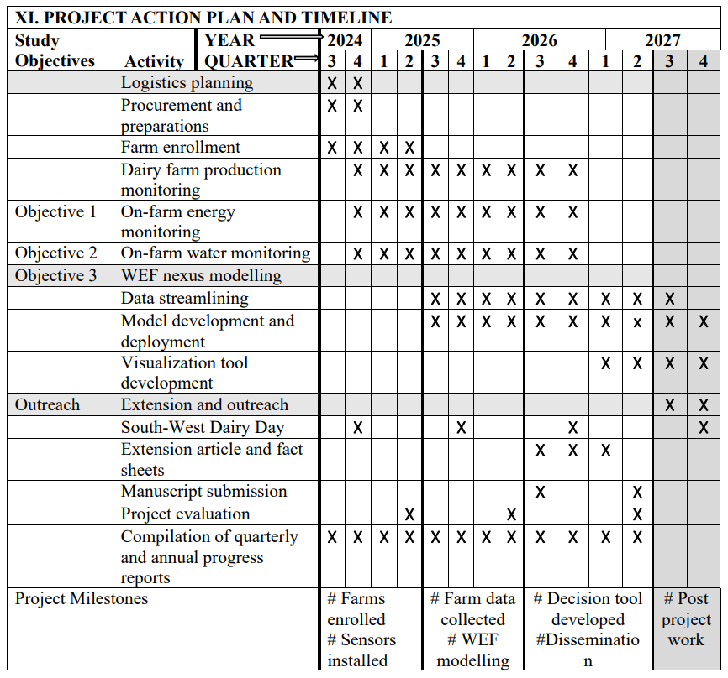
PROJECT TIMELINE

Slide 11
TECHNOLOGY TRANSFER
Project Website
Extension Articles & Factsheets
Scientific Dissemination
Demonstrations
Sustained Access
Notes:
Project Website: A dedicated website will be launched in the first trimester to share project updates, findings, and deliverables, including free access to the decision-making tool and supporting resources.Extension Articles & Factsheets: Three peer-reviewed articles will be published on AgriLife Learn and promoted through Texas Dairy Matters, local newsletters, and national dairy magazines like Progressive Dairy and Dairy Herd.Scientific Dissemination: Results will be presented at the Annual Meeting of the American Dairy Science Association and published in the Journal of Dairy Science for international reach.Demonstrations: The WEF-based tool and monitoring methods will be demonstrated during the annual Southwest Dairy Days, attended by approximately 300 producers representing over 615,000 dairy cows.Sustained Access: All tools and materials developed will remain accessible beyond the project period through the project website and Texas A&M AgriLife Extension platforms.

Slide 12
REFERENCES
1) Entrena-Barbero, E., Rebolledo-Leiva, R., Vásquez-Ibarra, L., Fernández, M., Feijoo, G., González-García, S., & Moreira, M. T. (2023). Water-Energy-Food nexus index proposal as a sustainability criterion on dairy farms. Science of the Total Environment, 874, 162507.
2) Haji, M., Govindan, R., & Al-Ansari, T. (2022). A computational modelling approach based on the ‘Energy-Water-Food nexus node’to support decision-making for sustainable and resilient food security. Computers & Chemical Engineering, 163, 107846.
3) Du, X., Yang, H., Gui, J., Wang, Q., Liu, Y., Li, H., ... & Shi, Z. (2024). Assessing the eco-efficiency of milk production systems using water-energy-labor-food nexus. Science of The Total Environment, 955, 176812.
4) Muell, J. D., Mohtar, R. H., Kan, E. S., Assi, A. T., & Pappa, V. (2022). Farm-scale water-energy-food-waste nexus analysis for a closed-loop dairy system. Frontiers in Environmental Science, 10, 880839.
5) Meyer, U., Everinghoff, M., Gädeken, D., & Flachowsky, G. (2004). Investigations on the water intake of lactating dairy cows. Livestock production science, 90(2-3), 117-121.
6) Elzaki, R. M., Al-Mahish, M., & Alzahrani, F. (2024). Water–Energy–Milk Nexus: Empirical Evidence from Saudi Arabia. Water, 16(11), 1538.
7) Namany, S., & Al-Ansari, T. (2021). Energy, water, food nexus decision-making for sustainable food security. The Water–Energy–Food Nexus: Concept and Assessments, 191-216.
8) Reynolds, C. K., Crompton, L. A., & Mills, J. A. (2010). Improving the efficiency of energy utilisation in cattle. Animal Production Science, 51(1), 6-12.
9) Rebolledo-Leiva, R., Barros, M. V., Entrena-Barbero, E., Vásquez-Ibarra, L., Fernández, M., Feijoo, G., ... & González-García, S. (2024). Embedding Water-Energy-Food nexus and circularity assessment for organization benchmarking: A case study for dairy farms. Waste Management, 189, 410-420.
10) Finley, J. W., & Seiber, J. N. (2014). The nexus of food, energy, and water. Journal of agricultural and food chemistry, 62(27), 6255-6262.
11) Murdock, S. H., White, S., Hoque, M. N., Pecotte, B., You, X., & Balkan, J. (2002). The Texas challenge in the twenty-first century: Implications of population change for the future of Texas. Department of Rural Sociology, Texas A&M University System Departmental technical report, 1.
12) Murdock, S. H., White, S., Hoque, M. N., Pecotte, B., You, X., & Balkan, J. (2002). The Texas challenge in the twenty-first century: Implications of population change for the future of Texas. Department of Rural Sociology, Texas A&M University System Departmental technical report, 1.
13) Garcia, D. J., Lovett, B. M., & You, F. (2019). Considering agricultural wastes and ecosystem services in Food-Energy-Water-Waste Nexus system design. Journal of cleaner production, 228, 941-955.

Slide 13

THANK YOU

Slide 14
Pitfalls:
Real-time Data Gaps
Data Granularity
Supplemental Monitoring
Contextual Understanding
Limitations:
Scope Restriction
Focused Assessment
Future Expansion
Streamlined Strategy
Notes:
Pitfalls:Real-time Data Gaps: Monthly electricity and water data may not detect leaks or equipment failures as they happen.Data Granularity: Metered data lacks detail on specific anomalies like non-routine maintenance or construction activities. Supplemental Monitoring: Farm management will be consulted periodically to explain irregular usage patterns and support data interpretation.Contextual Understanding: Combining quantitative data with on-farm insights will enhance the accuracy and relevance of resource assessments.Limitations:Scope Restriction: The project does not include a full life cycle assessment (LCA) of the entire dairy operation due to time and resource constraints.Focused Assessment: The study concentrates on direct resource use within operational systems (lactating cows) to identify practical, implementable improvements.Future Expansion: A more detailed LCA—including dry cows, calves, and pasture—may be pursued in future phases.Streamlined Strategy: Targeting key intervention areas allows for quicker adoption of sustainability practices and immediate value to stakeholders.

